Slide 1
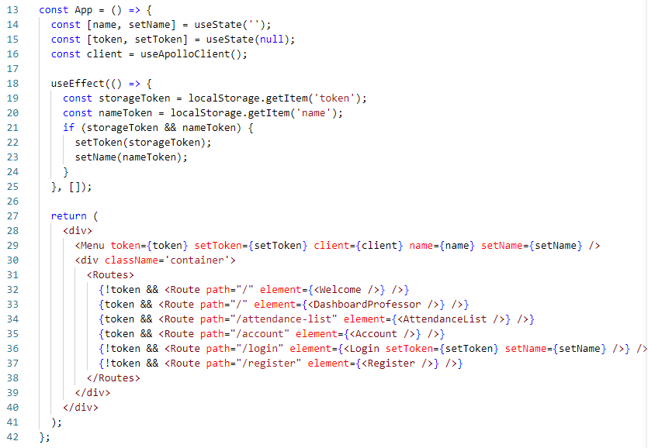
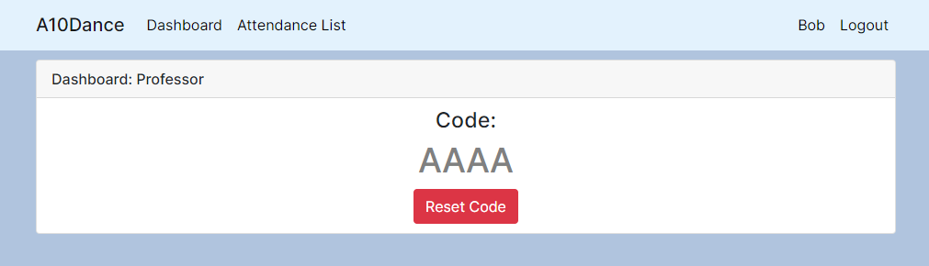
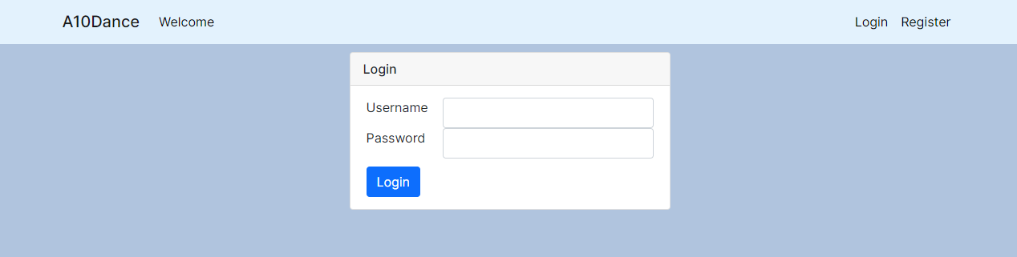
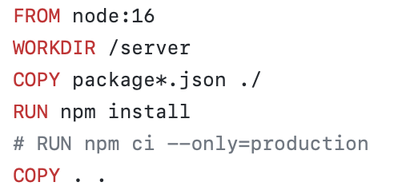
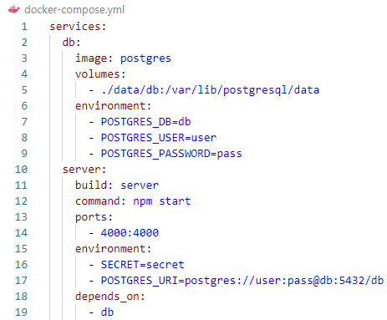
A10Dance Tracker
By: Josue Camilo, Danielle Rivas,
Kyara Scott, Long Vu, Jackson Wertz
https://github.com/josuecamilo/Attendance
Project Architecture
Attendance Server
WebUI
WebUI
React.js
Database
PostgreSQL
Attendance Server
Node.js
The graph demonstrates how the individual components of the program works together.
The database contains user information, classes, and attendance statistics for each student. The attendance server handles accessing and modifying information from the database. The WebUI can query the attendance server for information and tell it to make a modification to the database.
The screenshot shows a demo of the professor dashboard displaying an attendance code which students can use to check-in to the class.
The backend receives login information from the WebUI and return queries asked for after identification.
GraphQL is used to handle queries between the WebUI and attendance server.
If a user has logged in, the attendance server will allow them to access specific queries depending on their role like generating a code if they are a professor or entering a code for students.
Students and professors can create new accounts and login to their created one.
Students will be able to input a code generated by the professor to check-in.
The username and password inputted will be sent to the attendance server which will query the database for a valid user and return if the user is valid with correct credentials or warn if they entered an invalid password or username.
The front end is written using the following languages and libraries:
React.js/JSX
CSS
JavaScript
Bootstrap
Cloud Deployment
Kubernetes
Docker Containers
WebUI
React.js
Setups
Attendance Server
Node.js
GitHub
Push CI
Jenkins
Deploys
Database
PostgreSQL
Docker
Runs using CloudLab servers
Using a combination of Docker and Kubernetes
Jenkins:
Deployment on Kubernetes
Integration with GitHub
Used for continuous integration in order to automatically push out changed content to users
Docker builds and runs components required by the project
Dockerfile created for running Node/NGINX
Docker Compose ties different parts together
NGINX for hosting the WebUI
Node.js for Attendance Server
PostgreSQL database
Web Attendance Dockerfile
Docker Compose File

